Slide 1
Database Introduction
CS3431 Wong Database Systems I

Slide 2
Overview
Course Logistics
Database Management System Overview
Client-server database models
Relational Model

Slide 3
Course Overview
Database Management System (DBMS)
We will use Oracle, which commands the leading market share of relational DBMS’s.
Data Models
Relational Model
Entity-Relationship (ER) Model
Database
Create a database schema, build an actual database, and manipulate data
Query Language
Oracle SQL
Programming Language Connections
Java JDBC
Database Theory
Relational Algebra
Normalization

Slide 4
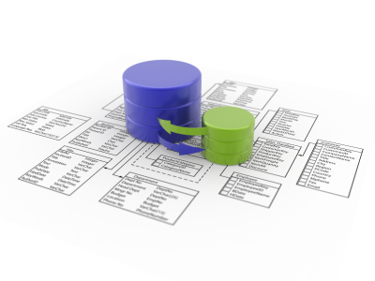
What is a Database System?
Software platform for managing large amounts of data
Managing means
Structuring, storing, and indexing the data
Querying
Different names refer to the same thing
Database systems
Database management systems
DBMS

Slide 5
What is a Database System? (Cont’d)
What is inside a DBMS
Collection of interrelated data (E.g., for a given application)
Set of programs to secure and access the data
An environment that is both convenient and efficient to use
Typically data is too large to fit in computer memory at once
Data stored on secondary storage – hard disks or the cloud
Typically many users want to access this data and do so fast
Databases touch all aspects of our lives and we often use it without knowing!

Slide 6
Basic Terminology
Database Management System (DBMS)
Software platform that allows us to create, stores, use, and maintain a database
Data Model
Tools used for describing the data
Data Schema
Describes structures for a particular application using the given model
Database
Collection of actual data that conforms to given schema
SQL & Data Manipulation Language (DML)
Language to manipulate, e.g., update or query, the data

Slide 7
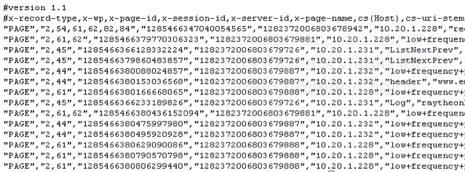


Why use DBMS, and not files?
The following are problems with data file systems that a DBMS fixes
Data redundancy and inconsistency
Multiple file formats, duplication of information in different files
Multiple records formats within the same file
No order enforced between fields
DBMS: data fields and keys
Difficulty in accessing data
Need to write a new program to carry out each new task
DBMS: provides a language (SQL) streamlined to do this
Integrity problems
DBMS: Integrity constraints
….
Account balance >= 0
Student cannot take same course twice

Slide 8
Why use DBMS, and not files? (Cont’d)
Maintenance problems
Hard to search for or update a field
Hard to add new fields
DBMS: Data definition language (DDL), DB schema
Concurrent access by multiple users
Many users need to access/update the data at the same time (concurrent access)
DBMS: Concurrent access (read and write) built into the system
Security problems
Hard to provide user access to some, but not all, data
DBMS: views, access control
Recovery from crashes
While updating the data the system crashes
DMBS: transactions - locking mechanism and rollbacks

Slide 9
A simple client/server system
The computer server is running database software that provides services to client software.
Client software accessing the database can even reside on the database server!

Slide 10
Client software, server software, and the SQL interface
Note that the results often are transmitted over a network. It is important to write efficient queries to transmit just what is needed.

Slide 11
A simple web-based system
How web applications work
Web browser on a client sends a request to a web server.
Web server processes the request.
Web server passes any data requests to the database server.
Database server returns results to web server.
Web server returns a response to the browser.

Slide 12
Data Model
A collection of tools for describing
Data objects
Data relationships
Data semantics
Data constraints
Several data models:
Relational model
Entity-Relationship (ER) conceptual data model
Semi-structured data model (XML)
Object-based data models (Object-oriented)
We will learn these two models

Slide 13
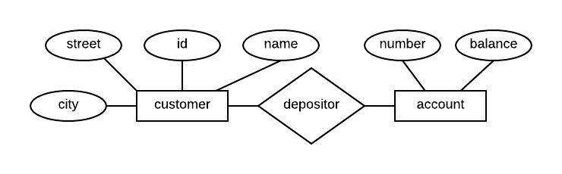
Entity-Relationship Model: Overview
Models the application as a collection of entities and relationships
Represented using Entity-Relationship Diagram (ERD)
Rectangles are tables and ovals are their fields.
Diamonds represent the relationships between tables.
Note: this is the conceptual ERD. The other ERD displays tables.

Slide 14
Relational Data Model: Overview
The most widely used model today
It is a tabular representation of the data
Main concepts:
Relations (Tables), basically a table with rows and columns
Every relation has a schema, which describes the columns, or fields
Columns: also described as attributes or fields
Rows: also described as records or tuples
Fields or attributes
ID | Customer_name | Street | City | Account_number
192-83-7465 | Johnson | 12 Alma St. | Palo Alto | A-101
364-90-2323 | Pine | 74 Elm St. | Redwood City | A-201
577-89-8101 | Hayes | 3 Main St. | Harrison | A-102
336-65-6999 | Lindsay | 175 Park Ave. | Pittsfield | A-322
321-72-1498 | Jones | 59 North St. | Pleasantville | A-217
Records or tuples
Notes:
5

Slide 15
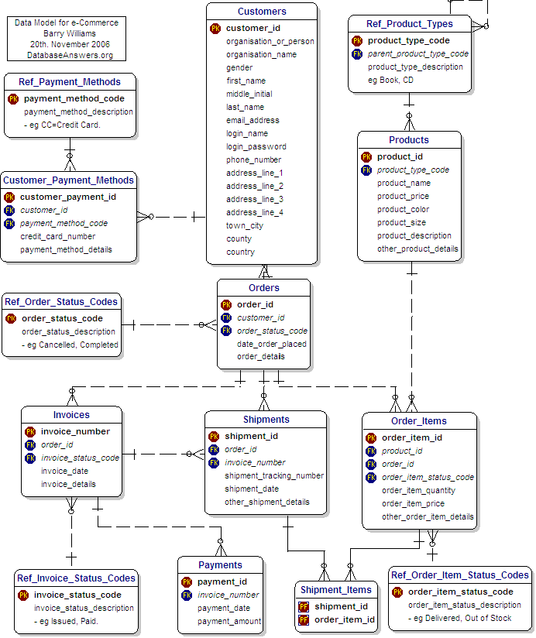
Data Schema
Captures the relationships between objects (“entities”) in an application
Schemas can be represented graphically or textual
Note: This is the other type of ERD!
Each rectangle is a table with a list of its fields (data types).
The lines represent the relationships between the tables.

Slide 16

Query Language (SQL)
Language for accessing and manipulating the data organized by the appropriate data model
SQL: Structured Query Language
SELECT ID, student_name
FROM Student
WHERE address='320FL';

Slide 17
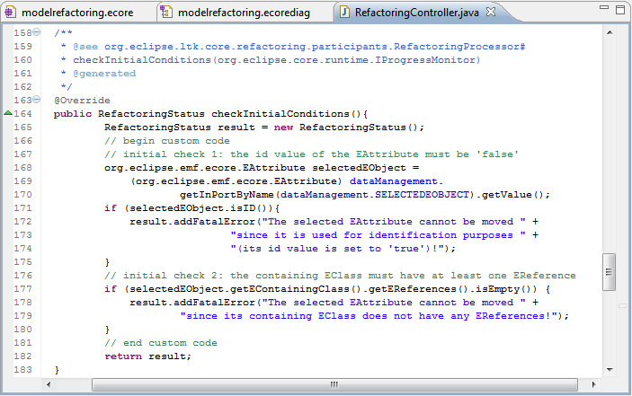
Query Language
Two classes of languages
Procedural – user specifies what data is is required and how to achieve that result, e.g. a for loop that goes through an entire array
Declarative (non-procedural) – user specifies what data is required without specifying how it is achieved
DBMS's use SQL
SELECT ID, student_name
FROM Student
WHERE address='320FL';
Red words are SQL commands
Items in black are tables, fields, and data

Slide 18
SQL: Overview
SQL: Non-procedural language to access the data inside a database
Example: Find the name of the customer with customer ID of 192-83-7465
select customer_name
from customer
where ID = '192-83-7465';
External programs, e.g., in C or Java, typically access the database by using:
Language extensions to allow embedded SQL
ODBC: Open Database Connectivity
JDBC: Java Database Connectivity

Slide 19
Levels of Abstraction
View Level – describes how users see the data
Logical Level – describes the logical structures used
Relational Model
ERD model
Physical Level – describes files and indexes
Usually hidden from users

Slide 20
View vs. Logical vs. Physical
ID | customer_name | street | city | account_number
192-83-7465 | Johnson | 12 Alma St. | Palo Alto | A-101
364-90-2323 | Pine | 74 Elm St. | Redwood City | A-201
577-89-8101 | Hayes | 3 Main St. | Harrison | A-102
336-65-6999 | Lindsay | 175 Park Ave. | Pittsfield | A-322
321-72-1498 | Jones | 59 North St. | Pleasantville | A-217

Slide 21
Levels of Abstraction: Airline Application Example
View Level (External Schema)
Passenger (ID, first_name, last_name, city, state, zip, flight_number)
Hide employees salary
Logical (Conceptual) Level
Passenger's name, address, birthdate, flight
Physical Level
Passenger table stored as a sorted file on the passenger's ID
Index on flight_number attribute for Flight relation

Slide 22
Data Independence
DBMS has the three levels of abstractions
Ability to modify one level without affecting the other levels
Logical data independence:
Logical schema can change, but views need not change
Protection from changes in logical structure of data
Physical data independence:
Protection from changes in physical structure, i.e. the physical representation, of data

Slide 23
Who uses databases?
End users
DB application programmers
Database administrators
Database design
Security, Authorization
Data availability, crash recovery
Database tuning (for performance)

Slide 24
Summary : Why study DBMS?
Need to process data, small and large, efficiently
Video, WWW, computer games, geographic information systems (GIS), genome data, digital libraries, etc.
Make use of all functionalities provided by DBMSs

Slide 25
Other Advanced Topics
Click to see slides for each topic
Efficient access
Query optimization
Concurrency control
Recovery control
Big Data Analytics
>> We will not have time to study these subjects during the course
>> It is important to know their existence and what is meant by each component

Slide 26
Acknowledgements
The PowerPoint slides are primarily created by me. Additional content is provided by the textbooks and occasionally by other instructors.

Slide 27
Efficient Access
Indexing
Indexes gives direct access to “necessary” portion of data, as opposed to sequential access in files
Example: Find the name of the customer with customer ID of 192-83-7465
select customer_name
from customer
where ID = '192-83-7465';
Directly find this customer without scanning all customers
Return to Other Advanced Topics

Slide 28
Query Optimization
Costing
Estimate expected execution times
Query optimization
Generates many alternatives to answer a query
Estimates the cost of each alternative
Automatically determine and prepare optimal (or near optimal) access plans for getting the data
SELECT ID, student_name
FROM Student
WHERE address='320FL';
Optimizer = "The Bread and Butter of a DBMS !"
Return to Other Advanced Topics

Slide 29
Concurrency Control
DBMS ensures data is consistent under concurrent access
E.g. multiple airline staff trying to reserve a seat for different customers
Concepts:
Transactions – grouping multiple instructions (reads/writes) into one atomic unit
Locks – locking of resources (tables)
Return to Other Advanced Topics

Slide 30
Recovery Control
If a system crashes in middle of transaction, recovery must be provided
Cannot afford to lose data or leave it inconsistent
Concepts
Logging of transactions’ actions
Ability to redo or undo transactions
Return to Other Advanced Topics

Slide 31
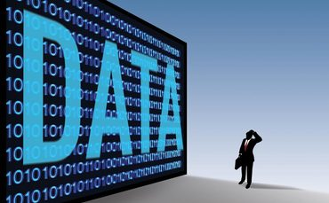
Big Data Analytics
Large-Scale Data Management
Big Data Analytics
Data Science and Analytics
How to manage very large amounts of data and extract value and knowledge from them

Slide 32
Data Explosion
Return to Other Advanced Topics

